Slide 2
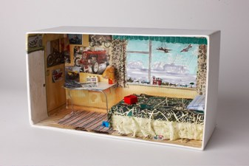
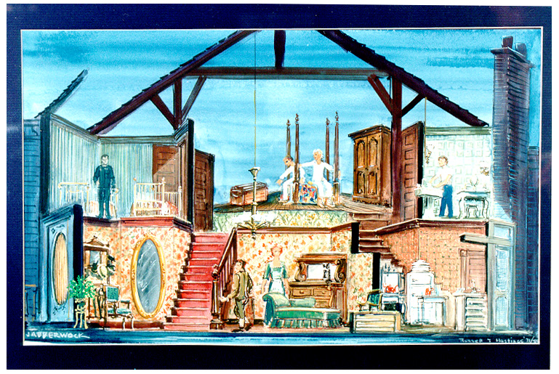
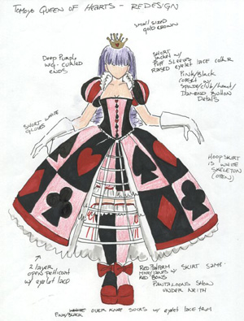
Creating a Costume or Set Design Project
Pick a character / scene from your favorite Movie, TV Show, Play, musical, book, etc…
You will create either a set model / or Costume Morgue of your choice.
You will also need to complete written reasoning for your choices, and why they work for the character/scene.
Everything must be in color!
You are not graded on your artistic ability, but you should be able to communicate your idea through your drawings. If you cannot do that, this may not be the best option for you.
← You could make a scale model with a shoe box!
Include notes on your drawings →

Slide 3
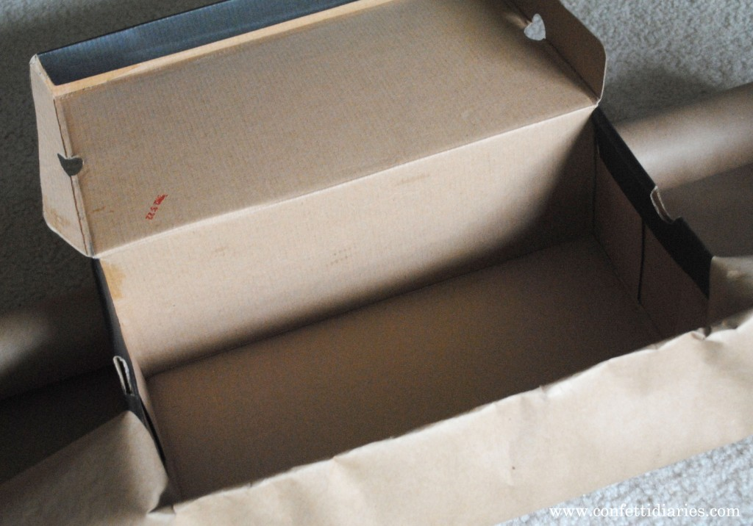
Shoebox
Set design!

Slide 4
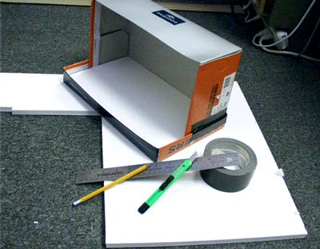
Grab some tape, glue and a box!

Slide 5
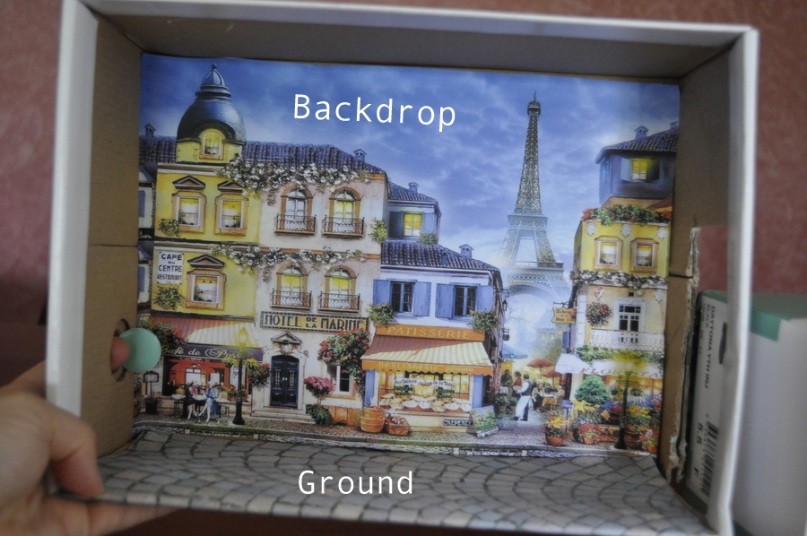
Add a magazine backdrop to all inside walls!

Slide 6
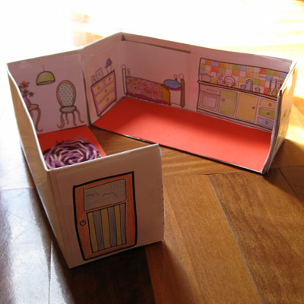
Or just Draw on the walls!

Slide 7
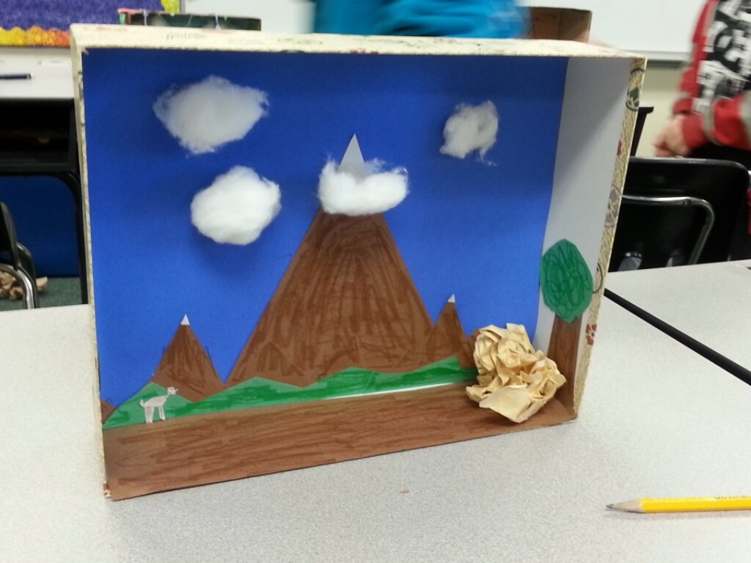
No materials? No problem!
Use what you have around the house!

Slide 8
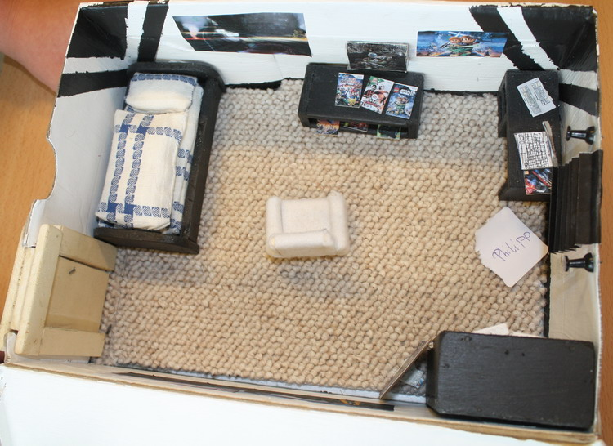
Fill It with your set design pieces!

Slide 9
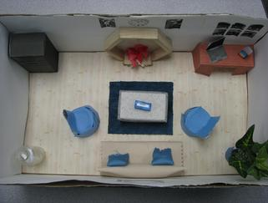
Make a ground plan and follow it to scale!

Slide 10
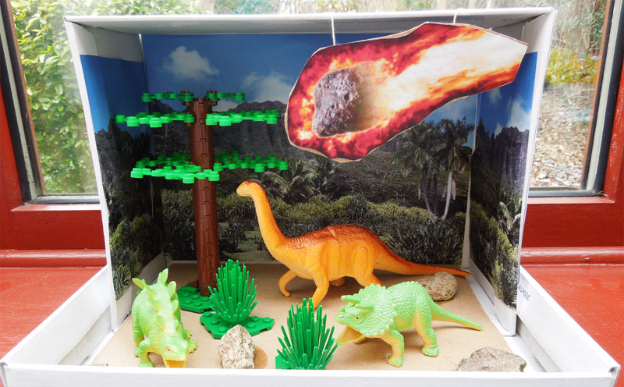
Get Creative!
Use legos, cardboard, figures, magazine pictures!

Slide 11
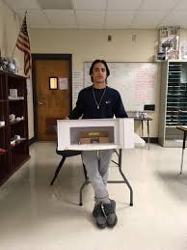
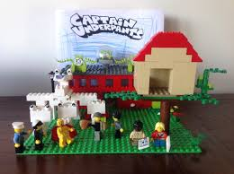
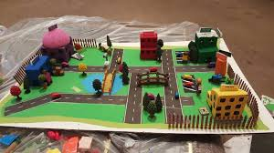

Slide 12
Shoebox Blurb
You are to write a short blurb which details the work you did in your shoebox design.
Focus on these areas;
  What did you design? For what play/scene/story?
  Is there a mood/theme/tone you were following?
  What materials did you use to create your set?
  How does this set represent your 3 freestanding objects?
  What did this project tell you about the job of a scenic designer?

Slide 13
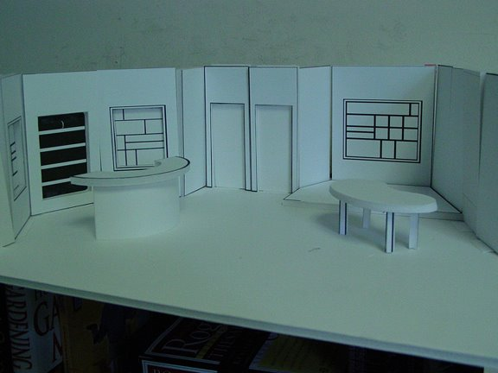
Get professional if you dare!

Slide 14
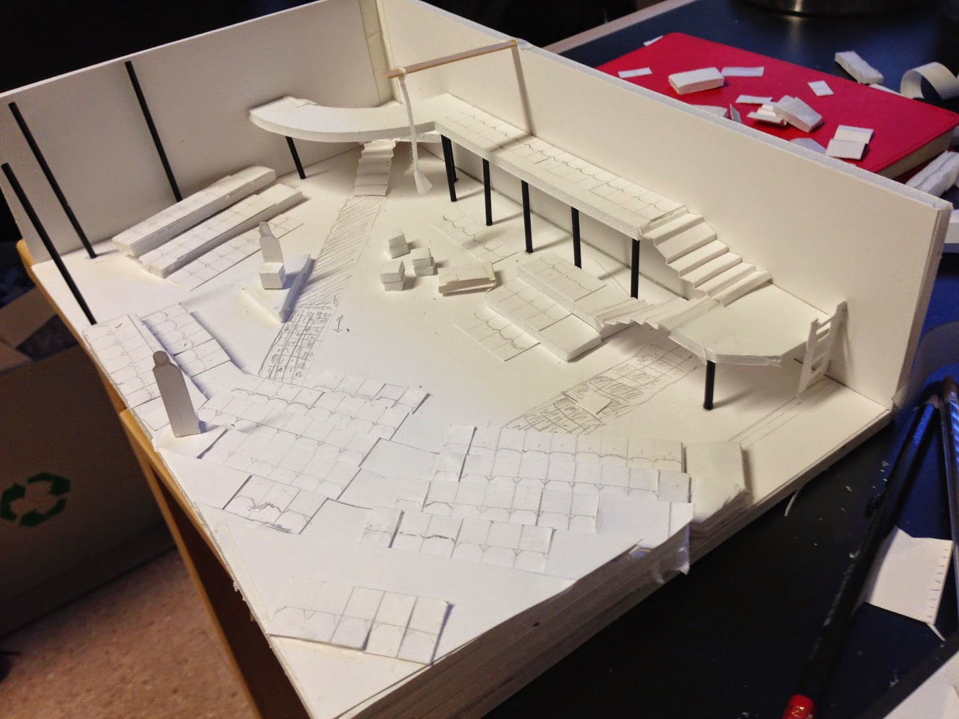

Slide 15
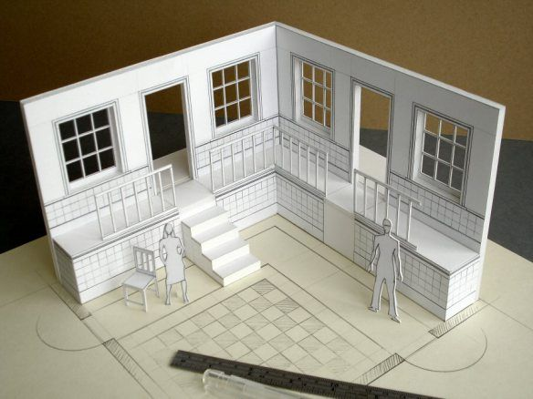

Slide 16
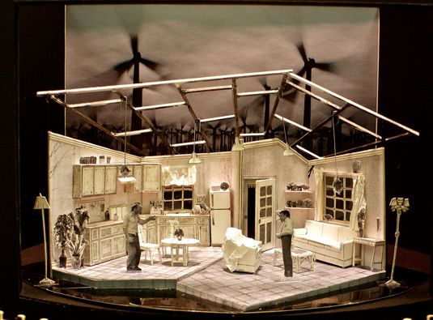

Slide 17
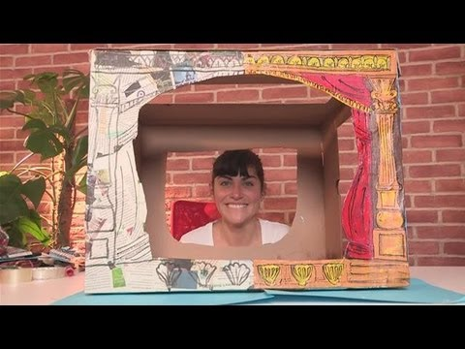
Either way…
Have fun designing your very own set!

Slide 18
Costume Design Project

Slide 19
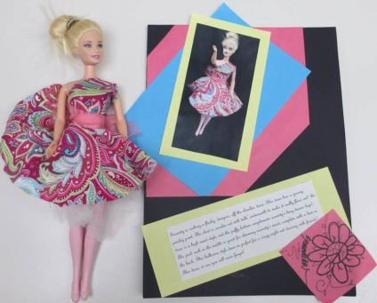
Figure Design

Slide 20
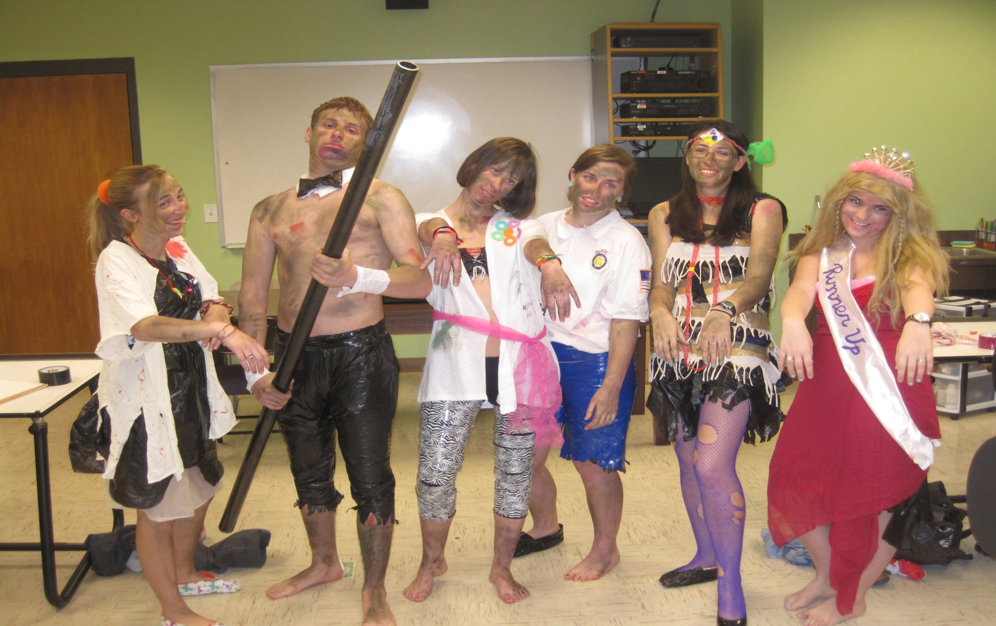
Themed “Dress Up” Design

Slide 21
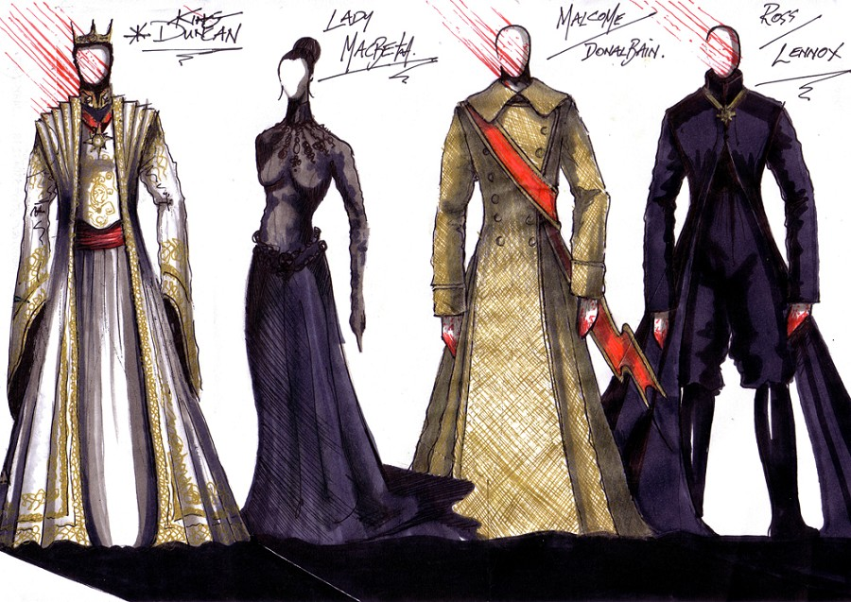
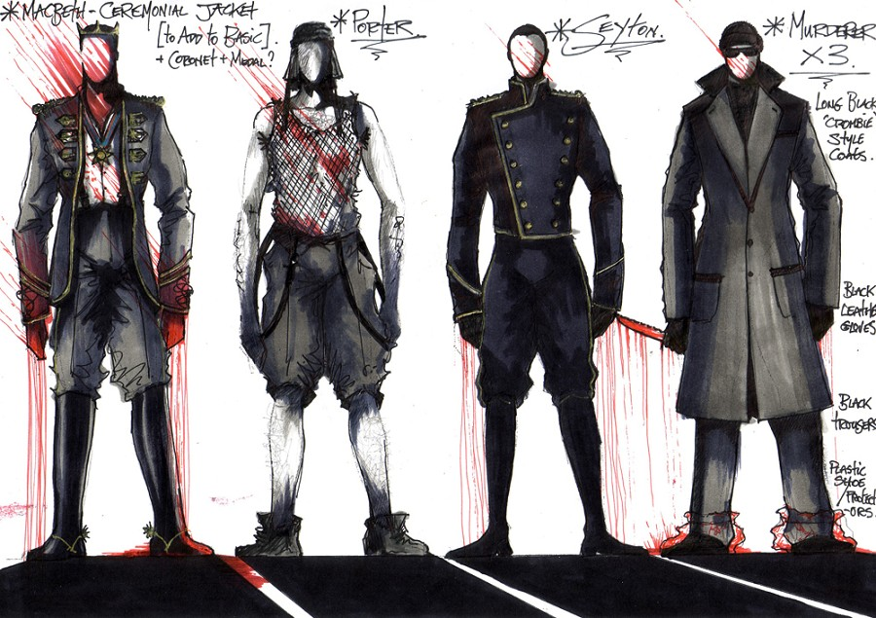
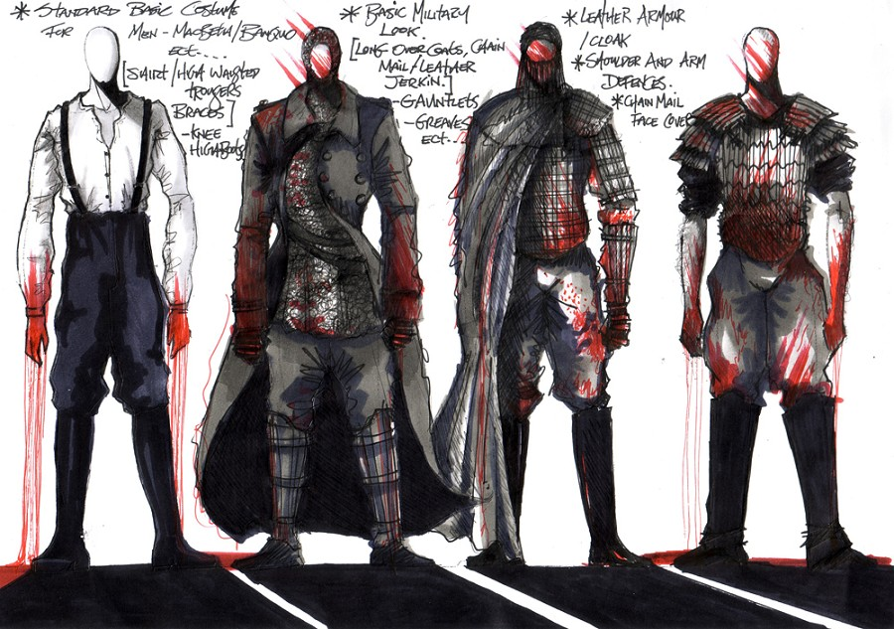
Costume Variety

Slide 22
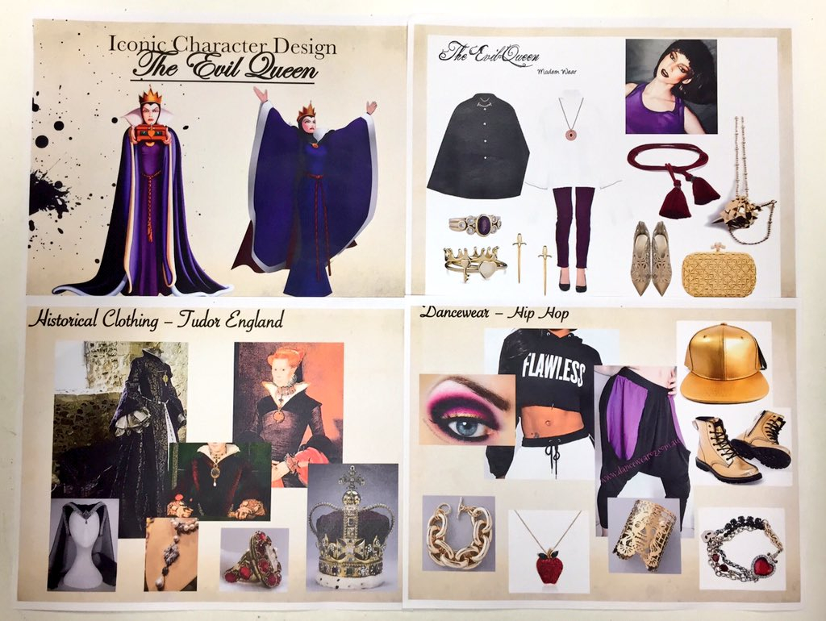
Magazine Inspirations

Slide 23
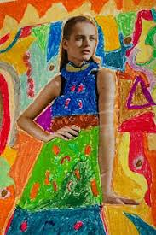
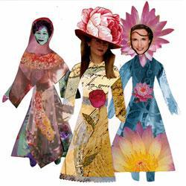
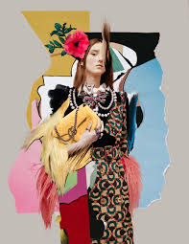
More Magazine Designs!

Slide 24
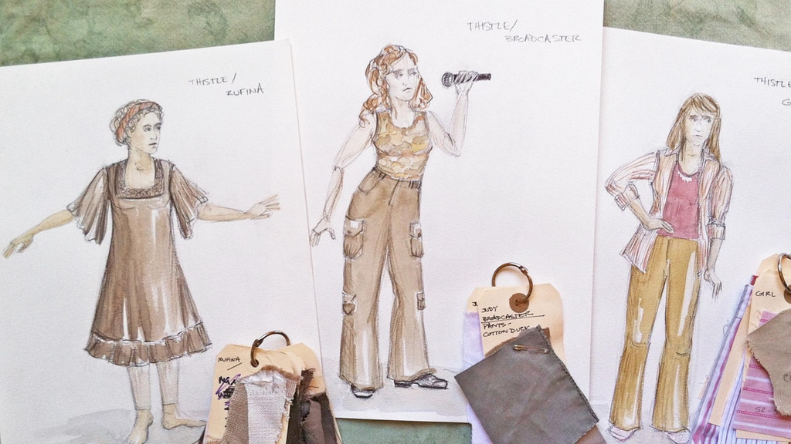
One Character, Different Costumes

Slide 25
COSTUME MORGUE
BY: BLESSING OKAFOR

Slide 26
THE PROCESS OF MAKING THE DRESS
I started by choosing an fabric. I chose a sky blue satin fabric for the project. I washed the fabric to remove any wrinkles or stain.
I then selected a pattern. My mom bought a 1950s vintage dress pattern to make it easier. I took your measurements even thought i was using a dress pattern to make sure it fits me.
  Place the pattern over your fabric.
  Then fold the fabric half lengthwise and trace around the outside to match both sides.
  Cut the fabric by Laying your fabric flat or folding it in half, because the pattern directs me to do so and place the pattern over the top.
  Follow your traced lines and the guide to cut out your fabric in the matching shapes.
  Cut along the line, and unfold the fabric to expose a complete front of your dress.
  Most patterns already have this included in their measurements, but you will need to keep this in mind if you are tracing a dress for your pattern.
  Cut your dress fabric in a tank-style top and then sew your sleeves on later. Be sure to cut the fabric for the back of this dress as well at this point, using the same method as you did to cut the front. B
  egin sewing by Follow the sewing directions on your pattern.I hand sew the entire dress but did the same thing.

Slide 27
THE CHARACTER THE DRESS IS BASED ON
The character my dress is based on is the named Juli Baker. Juli Baker falls instantly in love with her neighbor, Bryce Loski. Bryce, however, does not feel the spark. From that day forward, he (Callan McAuliffe) tries hard to keep brash and unpredictable Juli (Madeline Carroll) at bay.
In the movie Julei can be and strong as steel but is very loving especially over her favorite sycamore tree. She even stood-up for it when folks came to chop it down, she refuses to climb out of the branches. Juli doesn't hesitate before she does a kind deed. Not to forget she's really flexible. When she realizes Byce was a jerk she knew she had to move on. Eventually he gets her attention by planting a sycamore tree in her front yard.
The movie was made in 2010 but its setting is around the 1950s. There were a lot of plaid and stripes. I had to try something new. She has to go to homecoming and has to impress the guy she loved for six years. Who turn out to be her new boyfriend.

Slide 28
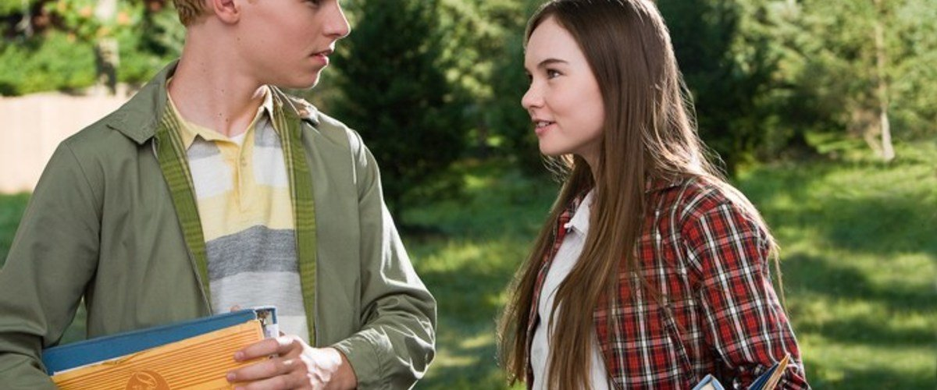

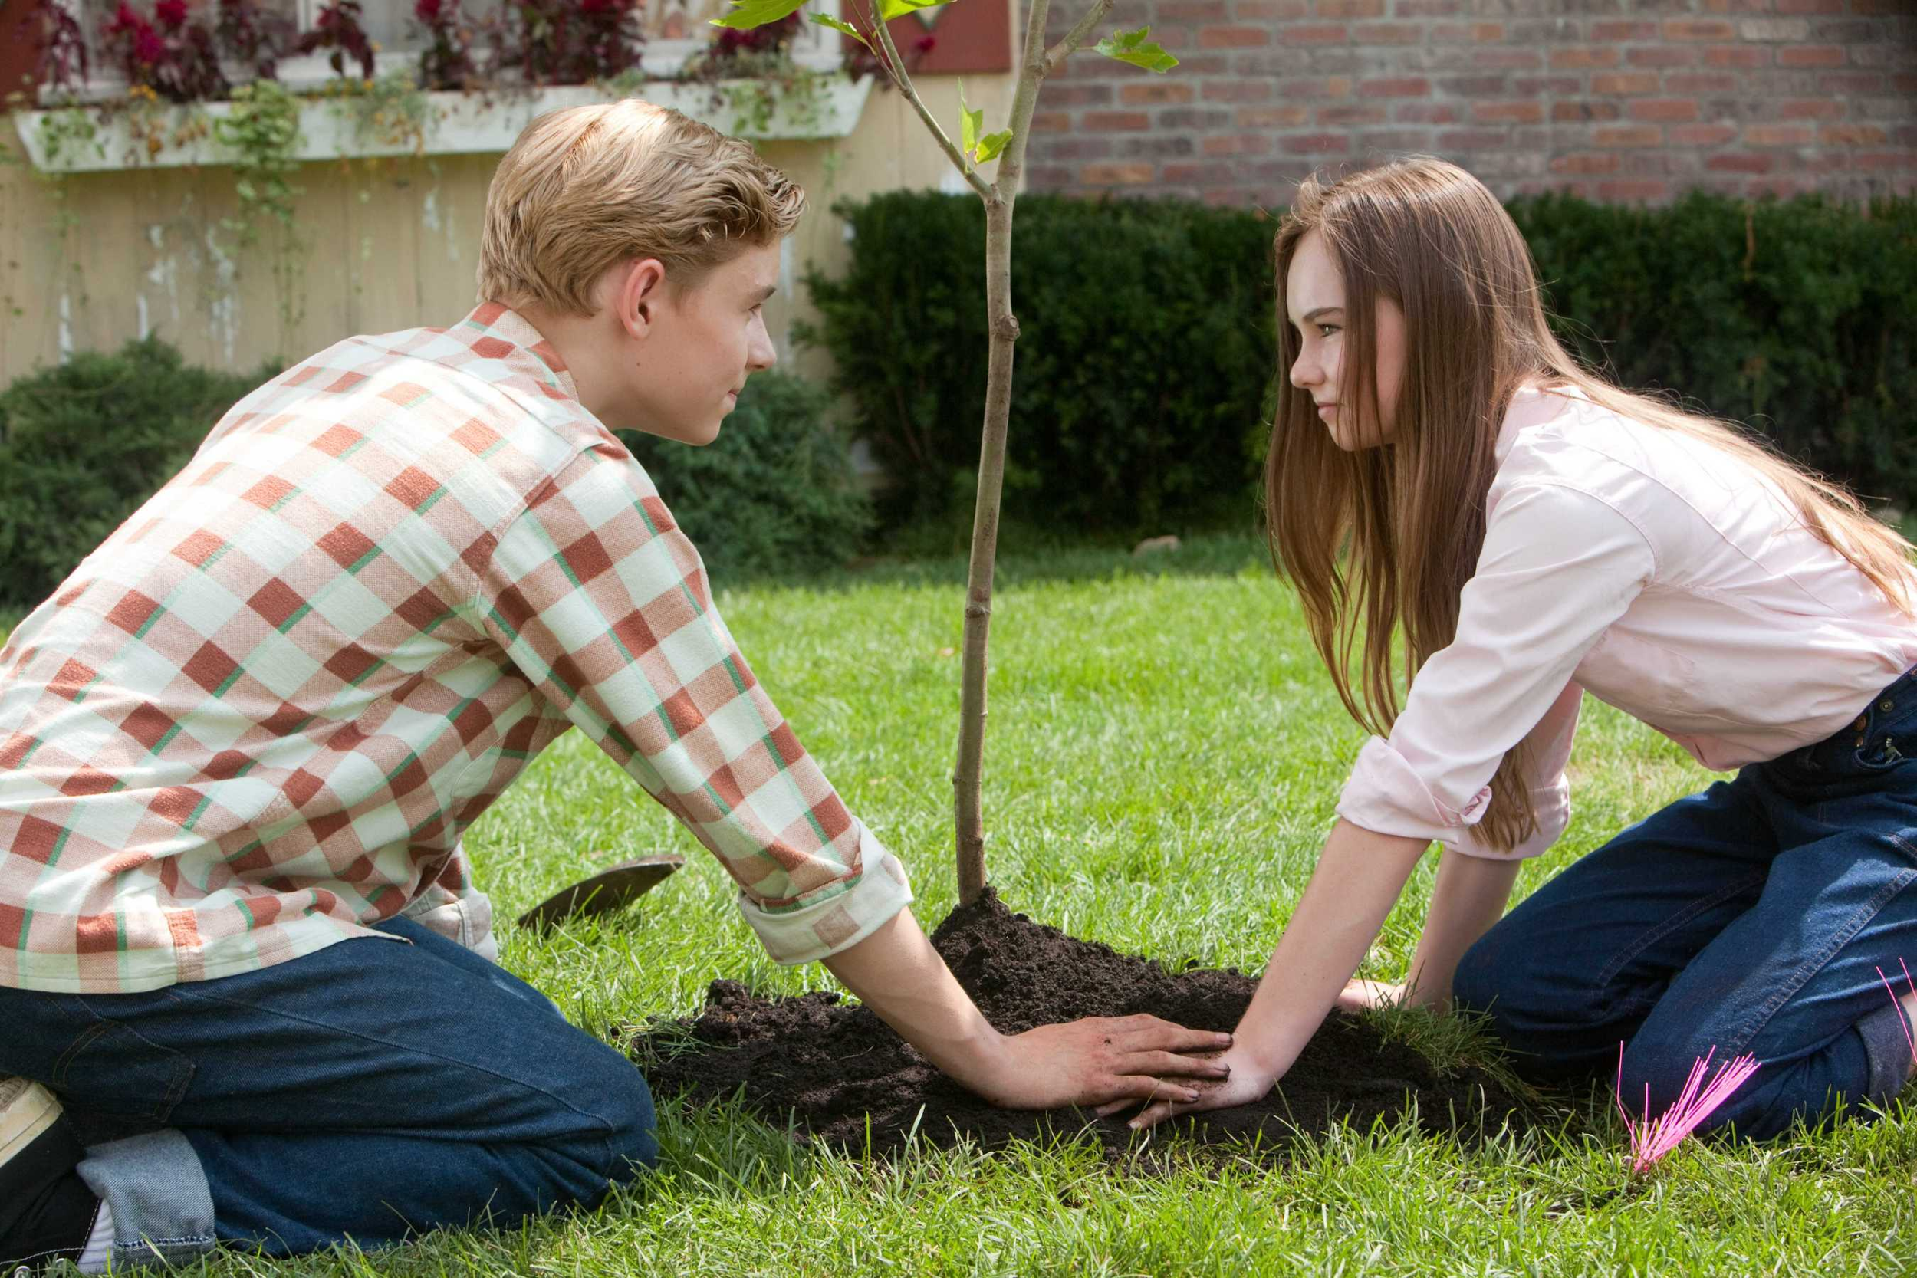
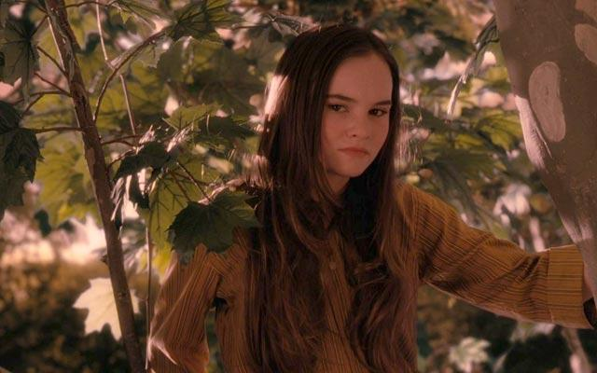
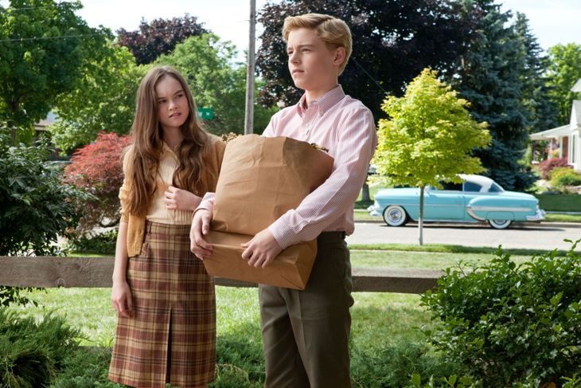
PICTURES

Slide 29
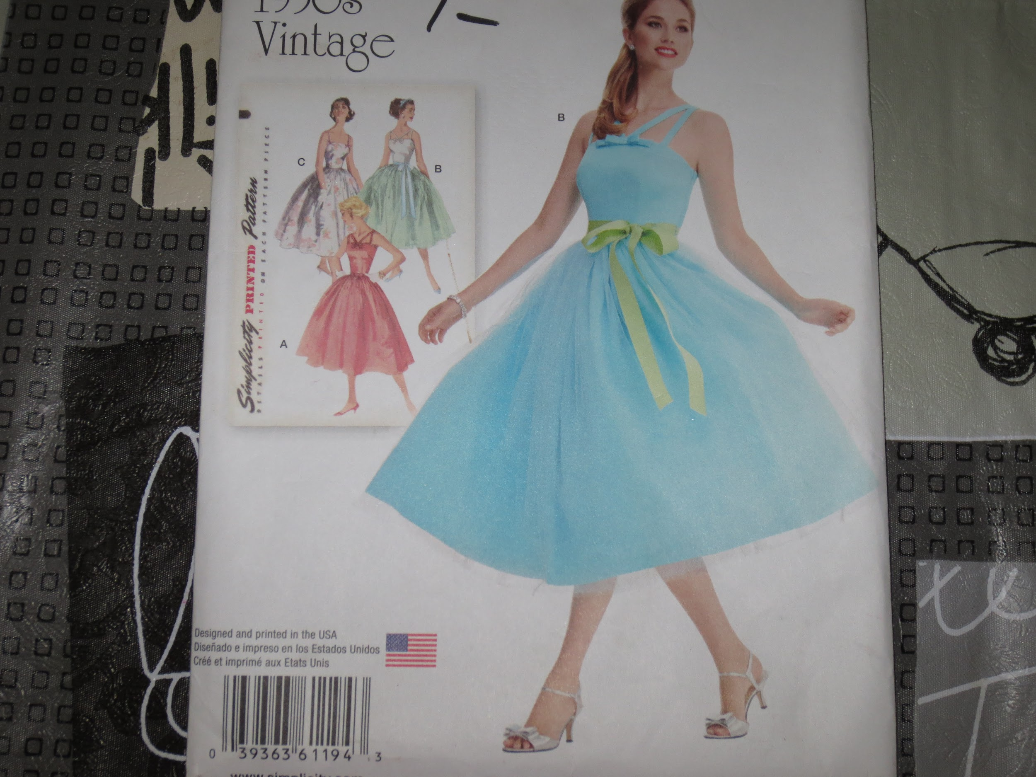
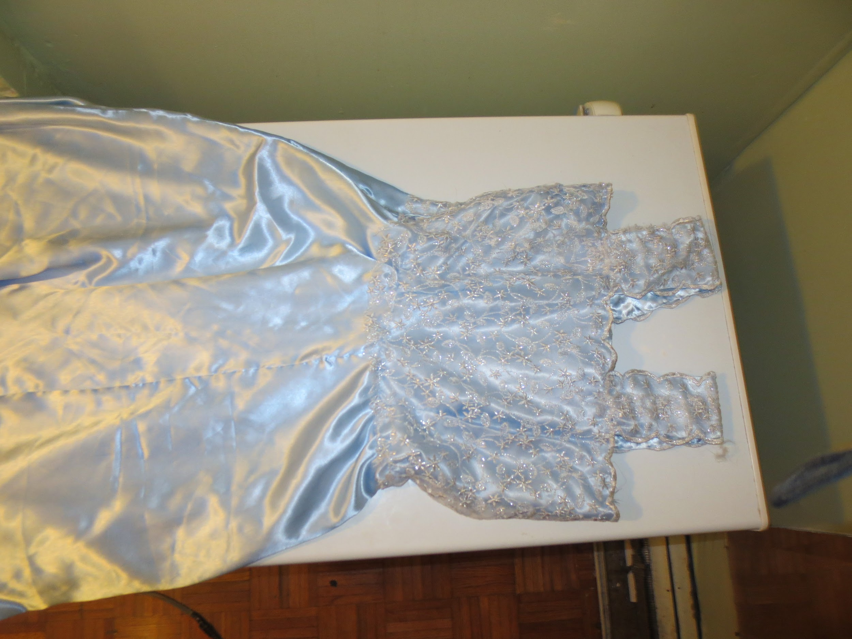
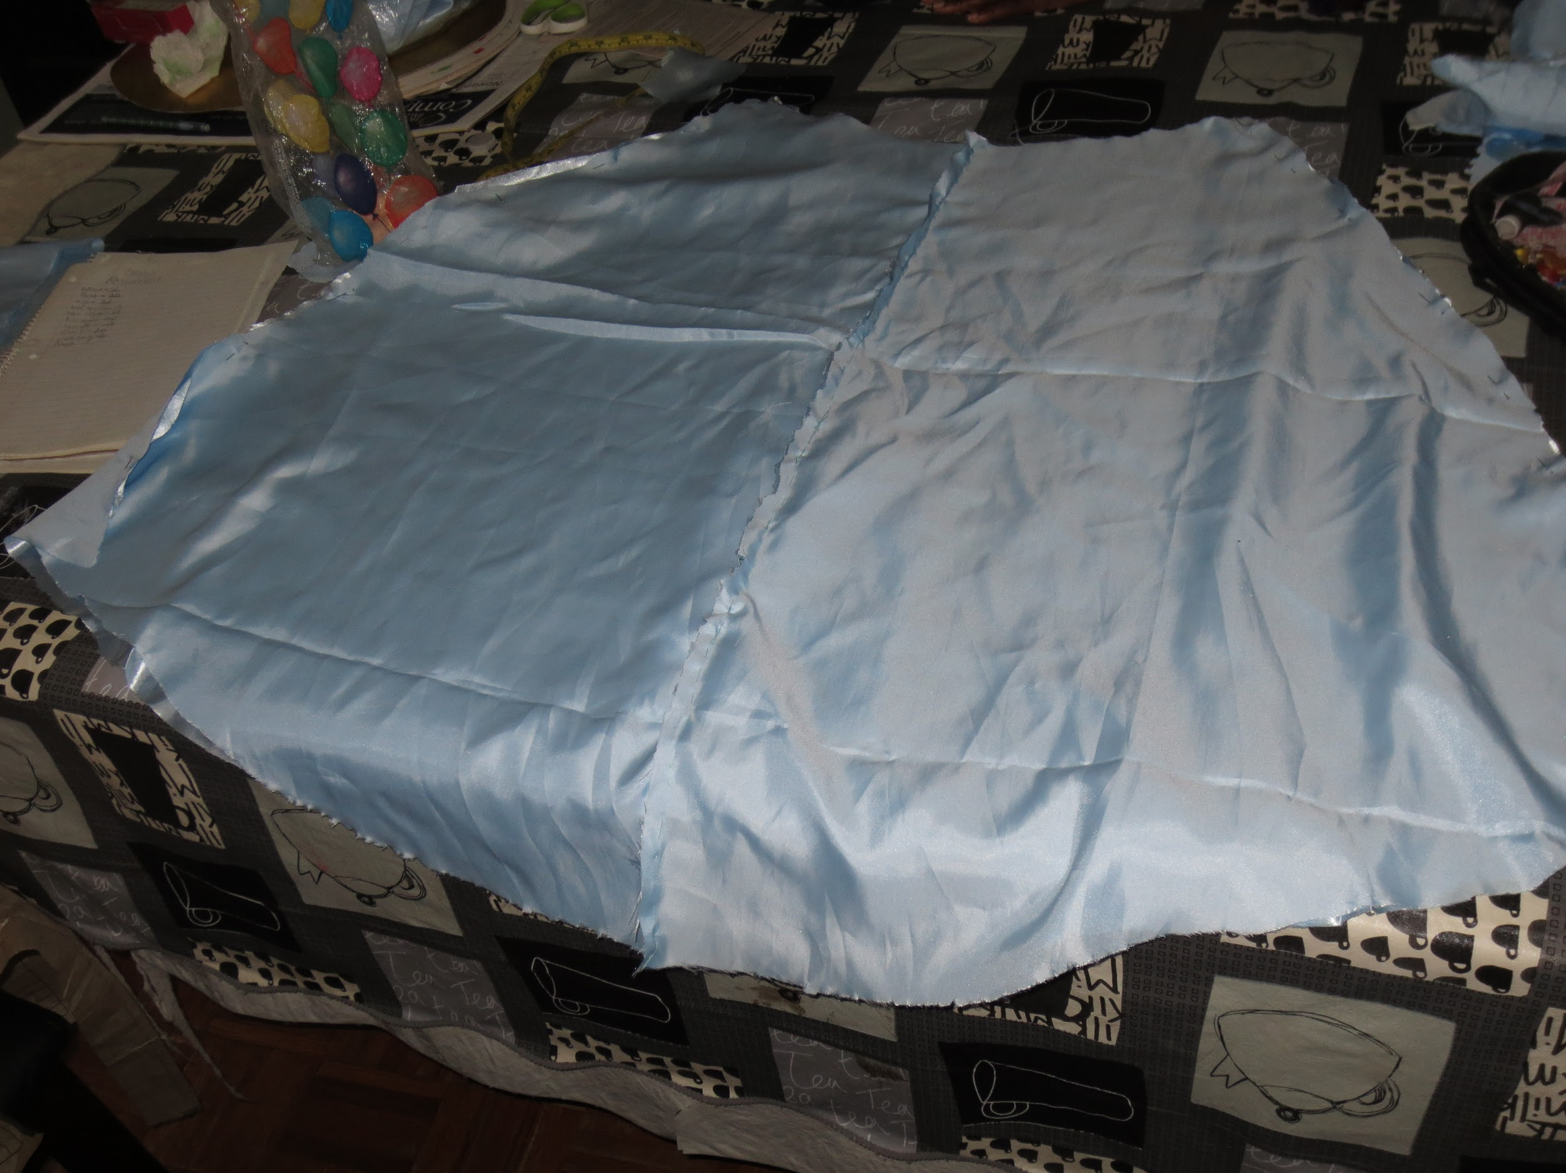
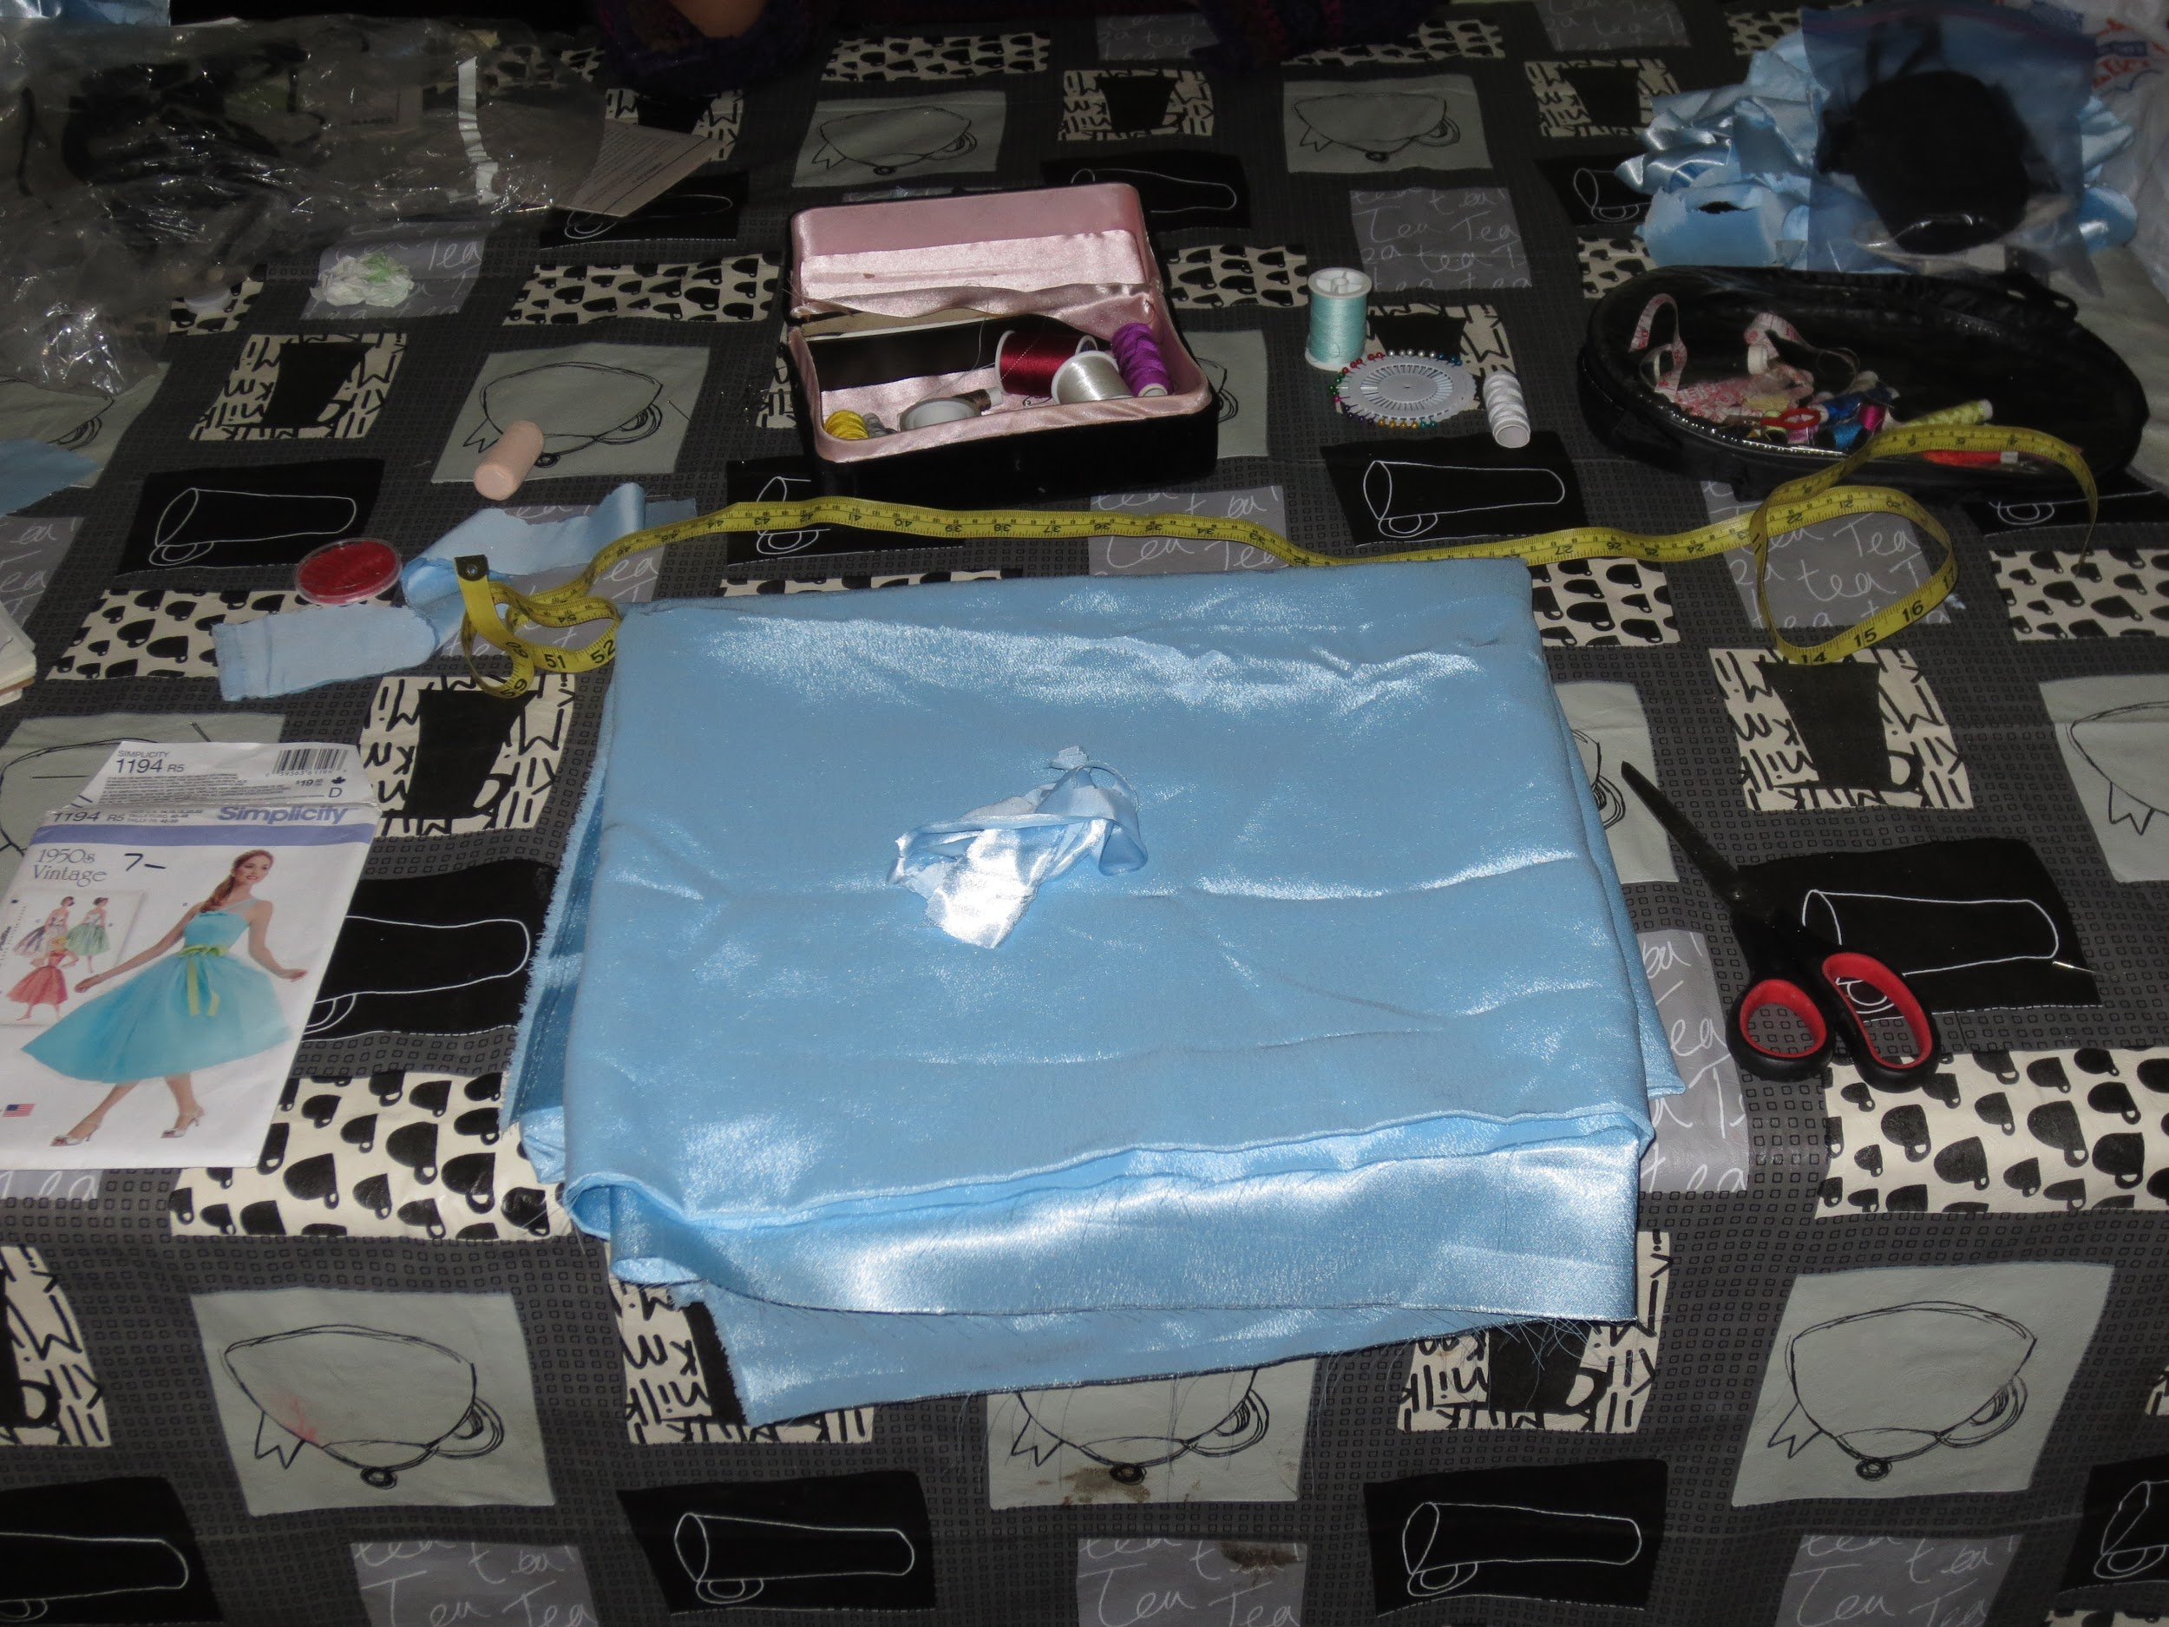

Slide 30
Creating a Costume or Set Design Project
Pick a character / scene from your favorite Movie, TV Show, Play, musical, book, etc…
You will create either a set model / or Costume Morgue of your choice.
You will also need to complete written reasoning for your choices, and why they work for the character/scene.
Everything must be in color!
You are not graded on your artistic ability, but you should be able to communicate your idea through your drawings. If you cannot do that, this may not be the best option for you.
← You could make a scale model with a shoe box!
Include notes on your drawings →

Slide 31
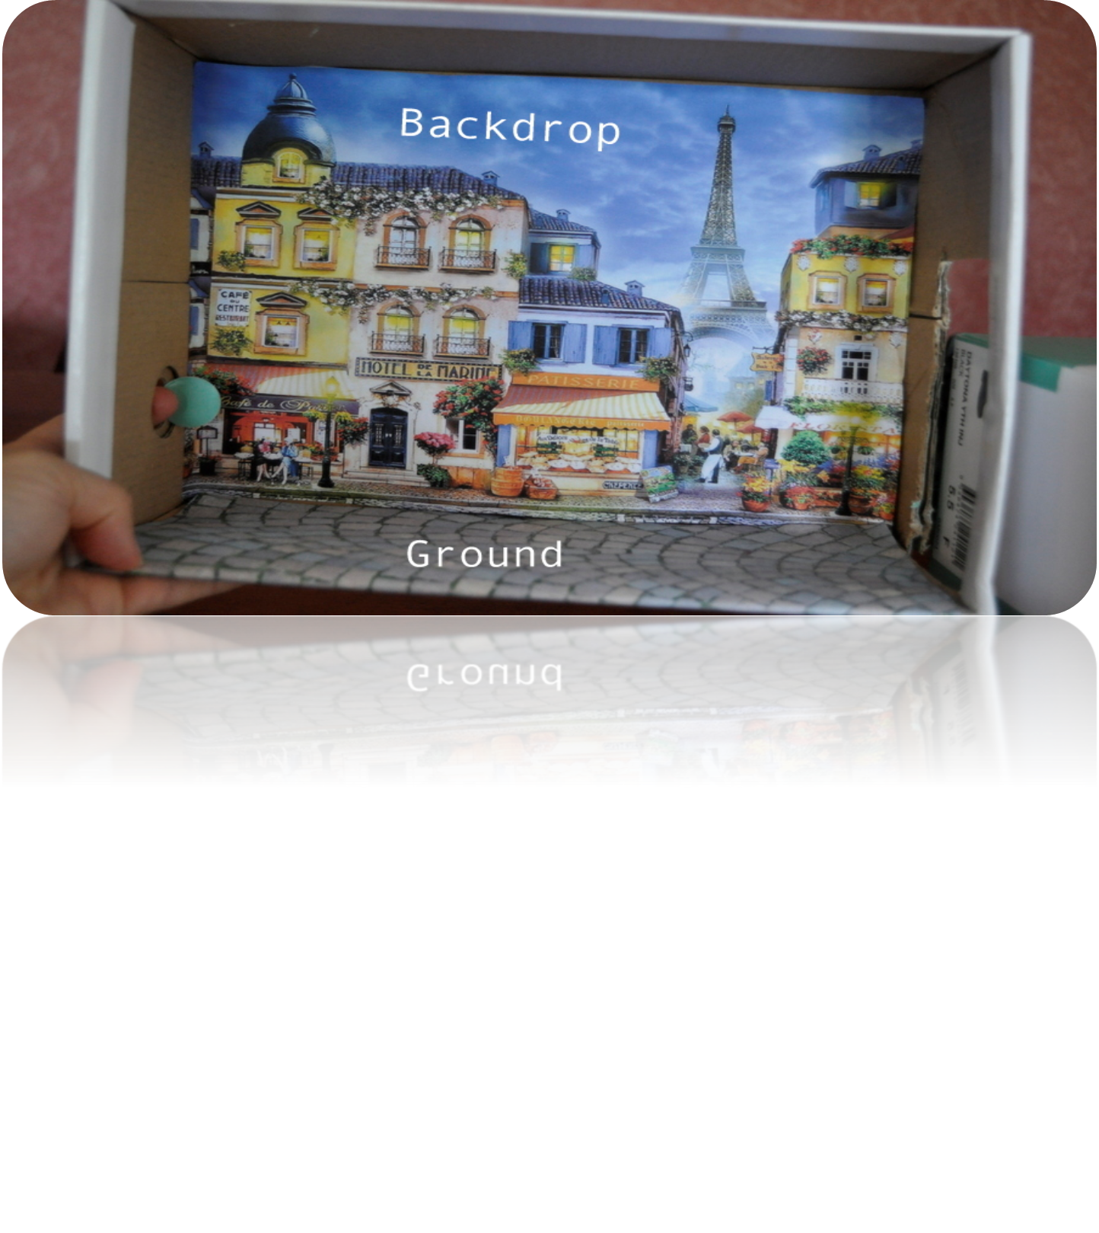
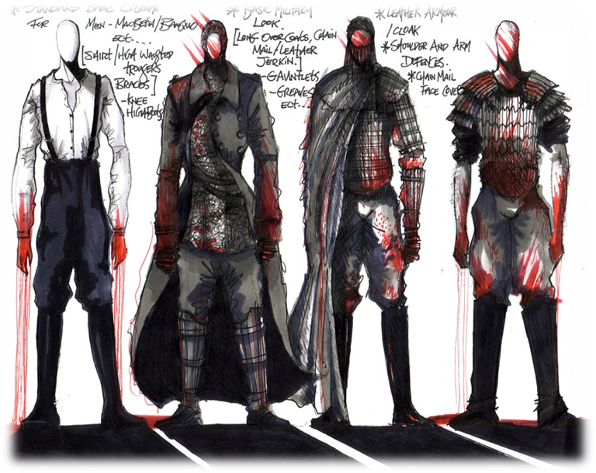
Your task today!
Decide which project your will be working on!
You will be given a Project Worksheet for your corresponding design choice.
Use the Chromebooks to research ideas and complete the first half of the worksheet.

